Slide 1
Things covered
Structural properties of networks
Pathlength in chain /star etc.
Network + dynamics: SI/SIS model in arbitrary networks (initial phase of infection vs leading eigenvector) Diffusion dynamics (Fixed point calculation for longer time evaluation)
Nonlinear dynamics: CR circuit/Bifurcation theory in 1d/Logistic Equation/ Lotka-Volterra dynamics/Love-hate problem/ Limit cycle (from complex plane to polar co-ordinate)/ two coupled phase oscillators (in weak coupling)

Slide 2
Things covered
Structural properties of networks
Pathlength in chain /star etc.
Network + dynamics: SI/SIS model in arbitrary networks (initial phase of infection vs leading eigenvector) Diffusion dynamics (Fixed point calculation for longer time evaluation)
Nonlinear dynamics: CR circuit/Bifurcation theory in 1d/Logistic Equation/ Lotka-Volterra dynamics/Love-hate problem/ Limit cycle (from complex plane to polar co-ordinate)/ two coupled phase oscillators (in weak coupling)
DEGREE DISTRIBUTION of complex networks
Percolation and emergence of random network

Slide 3
Percolation Theory

Slide 4
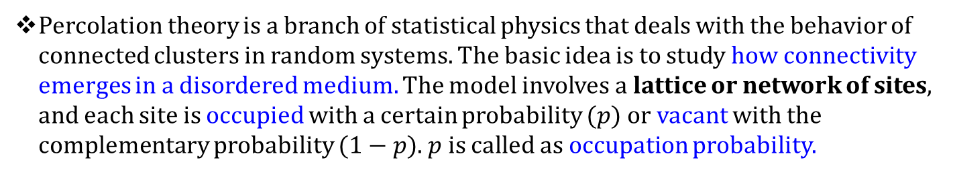
Percolation Theory
Percolation theory is a branch of statistical physics that deals with the behavior of connected clusters in random systems. The basic idea is to study how connectivity emerges in a disordered medium. The model involves a lattice or network of sites, and each site is occupied with a certain probability $(p)$or vacant with the complementary probability $(1−p)$. $p$ is called as occupation probability.

Slide 5
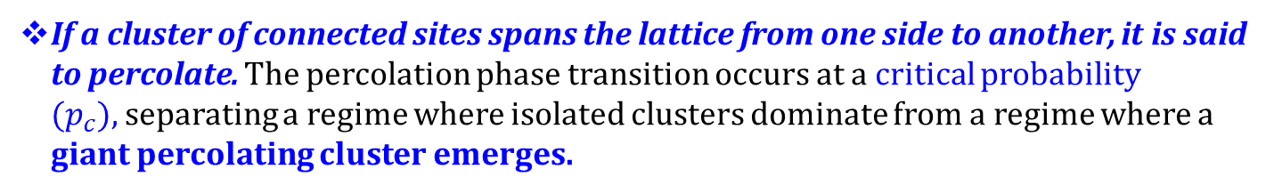
Percolation Theory
Percolation theory is a branch of statistical physics that deals with the behavior of connected clusters in random systems. The basic idea is to study how connectivity emerges in a disordered medium. The model involves a lattice or network of sites, and each site is occupied with a certain probability $(p)$or vacant with the complementary probability $(1−p)$. $p$ is called as occupation probability.
The most common example is the percolation on a square lattice, where sites are connected to their nearest neighbors.
If a cluster of connected sites spans the lattice from one side to another, it is said to percolate. The percolation phase transition occurs at a critical probability $(p_{c}),$separating a regime where isolated clusters dominate from a regime where a giant percolating cluster emerges.

Slide 6
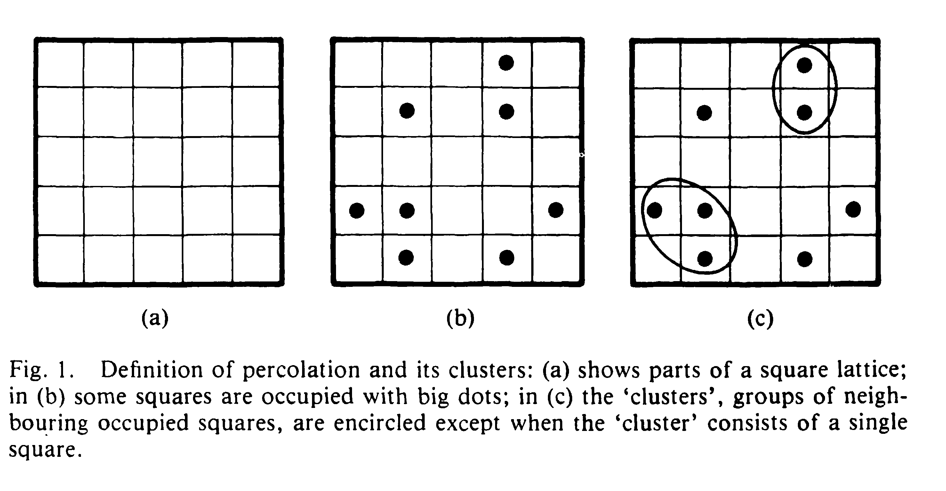
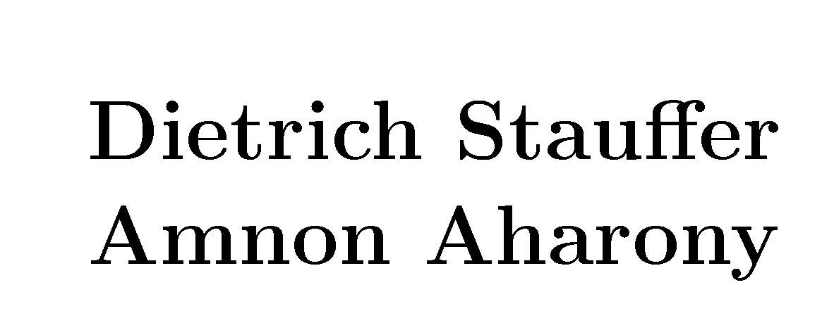

Slide 7
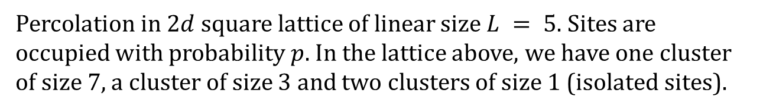
Percolation Theory
Percolation in $2d$ square lattice of linear size $L = 5.$Sites are occupied with probability $p$. In the lattice above, we have one cluster of size 7, a cluster of size 3 and two clusters of size 1 (isolated sites).
A cluster is a group of nearest neighbouring occupied sites.
Dr. Kim Christensen

Slide 8
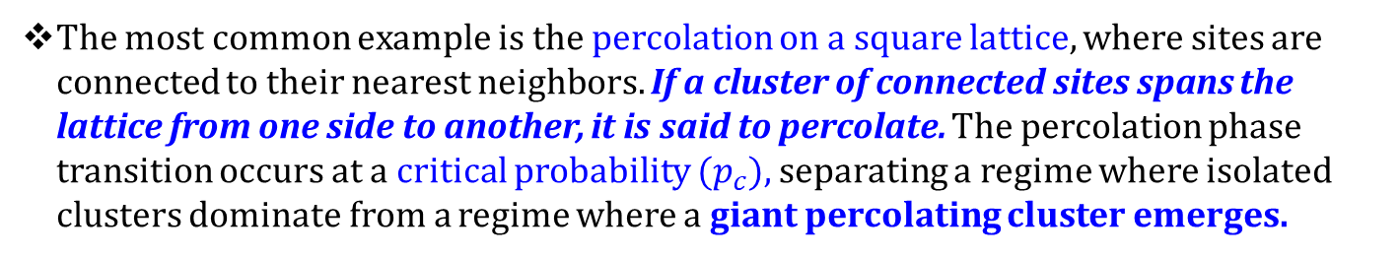

Percolation Theory
Percolation theory is a branch of statistical physics that deals with the behavior of connected clusters in random systems. The basic idea is to study how connectivity emerges in a disordered medium. The model involves a lattice or network of sites, and each site is occupied with a certain probability $(p)$or vacant with the complementary probability $(1−p)$. $p$ is called as occupation probability.
The most common example is the percolation on a square lattice, where sites are connected to their nearest neighbors. If a cluster of connected sites spans the lattice from one side to another, it is said to percolate. The percolation phase transition occurs at a critical probability $(p_{c}),$separating a regime where isolated clusters dominate from a regime where a giant percolating cluster emerges.
Understanding percolation theory involves studying the critical behavior near the percolation threshold, where small changes in the probability of occupation can lead to drastic changes in the system's macroscopic properties. This behavior is often characterized by critical exponents and scaling laws.

Slide 9
Percolation Theory
Fractals, which are objects with self-similar structure at different scales, are intimately related to percolation theory. The clusters formed during percolation often exhibit fractal characteristics, and the study of percolation provides insights into the formation of fractal structures in various physical systems.
Scaling is a key concept in percolation theory, describing how macroscopic properties of a system depend on its size. Near the critical point, certain properties exhibit scaling behavior, where they can be expressed as power laws. The renormalization group theory is a powerful tool used to understand the scaling behavior and critical phenomena in percolation and other systems.
The application of percolation theory extends beyond physics to various fields, including biology, geophysics, and even practical applications like oil recovery. In biology, percolation models have been used to study processes like disease spreading in populations. In geophysics, percolation is relevant for understanding phenomena like fluid flow through porous rock. In oil recovery, percolation concepts can be applied to optimize the extraction of oil from reservoirs.

Slide 10
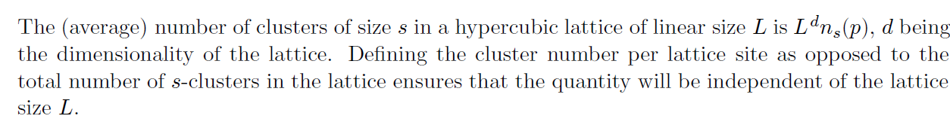
Percolation Theory
A cluster is a group of nearest neighbouring occupied sites.
The cluster number ${n_{s}}_{}(p)$denotes the number of s-clusters per lattice site.
The percolation threshold $p_{c}$is the concentration (occupation probability) $p$ at which an infinite cluster appears for the first time in an infinite lattice.
Dr. Kim Christensen

Slide 11
Percolation Theory
Two sites are connected if they are nearest neighbors (4 neighbors on square lattice)
• a cluster is a set of connected sites
• a cluster is spanning if it spans from one side to the opposite side
• a cluster that is spanning is called the spanning cluster
• a system is percolating if there is a spanning cluster in the system
Someone who is studying percolation process will focus on
characterization of the sizes of connected regions,
the size of the region connecting one side to another,
the size of the region that contributes to transport (fluid, thermal or electrical transport), and other geometrical properties of the system.
Most of the features we study will be universal – independent of many of the details of the system.

Slide 12
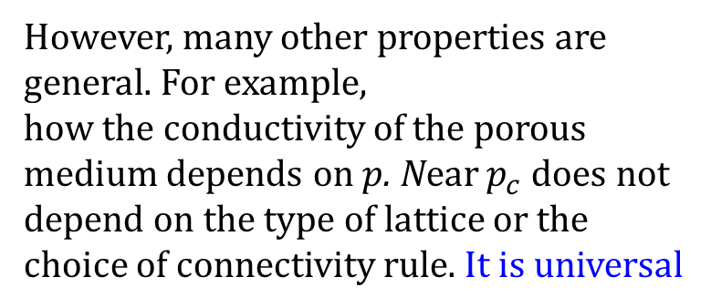
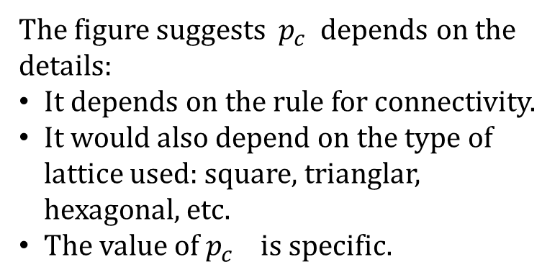
Percolation Theory
The figure suggests $p_{c}$ depends on the details:
It depends on the rule for connectivity.
It would also depend on the type of lattice used: square, trianglar, hexagonal, etc.
The value of $p_{c}$ is specific.
However, many other properties are general. For example,
how the conductivity of the porous medium depends on $p$. Near $p_{c}$ does not depend on the type of lattice or the choice of connectivity rule. It is universal
Anders Malthe-Sorenssen

Slide 13
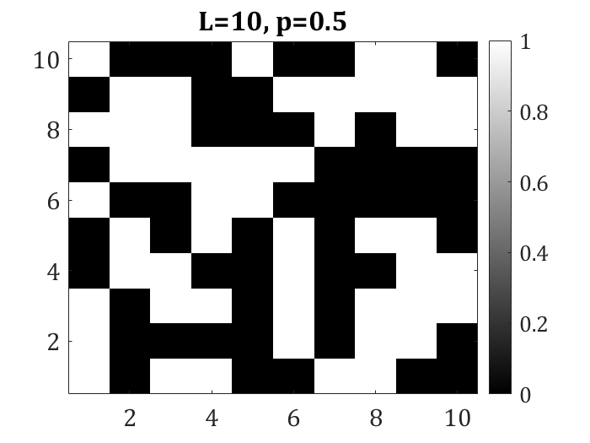
Percolation in 2-d
L = 20;
p = 0.5;
z = rand(L,L);
m = z<p;
imagesc(m);
Marking the clusters
1 | 2 | 3 | 4 | 5 | 6 | 7 | 8 | 9 | 10
1
2
3
4
5
6
7
8
9
10
1 | 0 | 6 | 6 | 0 | 0 | 10 | 10 | 0 | 0
1 | 0 | 0 | 0 | 0 | 8 | 0 | 10 | 10 | 0
1 | 0 | 5 | 5 | 0 | 8 | 0 | 10 | 10 | 10
0 | 5 | 5 | 0 | 0 | 8 | 0 | 0 | 10 | 10
0 | 5 | 0 | 3 | 0 | 8 | 0 | 10 | 10 | 0
2 | 0 | 0 | 3 | 3 | 0 | 0 | 0 | 0 | 0
0 | 3 | 3 | 3 | 3 | 3 | 0 | 0 | 0 | 0
3 | 3 | 3 | 0 | 0 | 0 | 9 | 0 | 9 | 9
0 | 3 | 3 | 0 | 0 | 9 | 9 | 9 | 9 | 9
4 | 0 | 0 | 0 | 7 | 0 | 0 | 9 | 9 | 0
Anders Malthe-Sorenssen

Slide 14
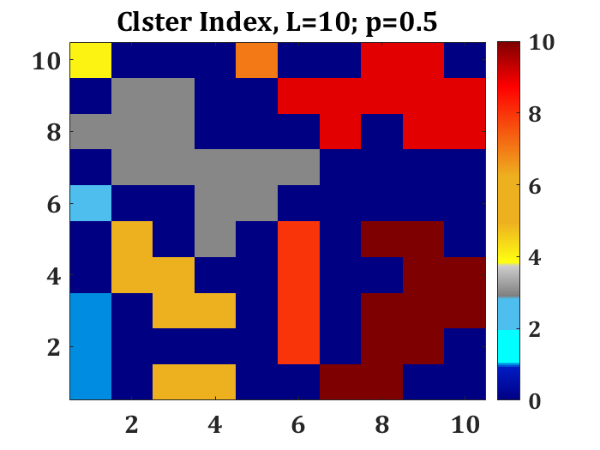
Percolation in 2-d
L = 20;
p = 0.5;
z = rand(L,L);
m = z<p;
imagesc(m);
[lw,num] = bwlabel(m,4);
imagesc(lw)

Slide 15
Percolation in 2-d
1 | 2 | 3 | 4 | 5 | 6 | 7 | 8 | 9 | 10
1
2
3
4
5
6
7
8
9
10
1 | 0 | 6 | 6 | 0 | 0 | 10 | 10 | 0 | 0
1 | 0 | 0 | 0 | 0 | 8 | 0 | 10 | 10 | 0
1 | 0 | 5 | 5 | 0 | 8 | 0 | 10 | 10 | 10
0 | 5 | 5 | 0 | 0 | 8 | 0 | 0 | 10 | 10
0 | 5 | 0 | 3 | 0 | 8 | 0 | 10 | 10 | 0
2 | 0 | 0 | 3 | 3 | 0 | 0 | 0 | 0 | 0
0 | 3 | 3 | 3 | 3 | 3 | 0 | 0 | 0 | 0
3 | 3 | 3 | 0 | 0 | 0 | 9 | 0 | 9 | 9
0 | 3 | 3 | 0 | 0 | 9 | 9 | 9 | 9 | 9
4 | 0 | 0 | 0 | 7 | 0 | 0 | 9 | 9 | 0
Each of the color represents each disjoint cluster

Slide 16
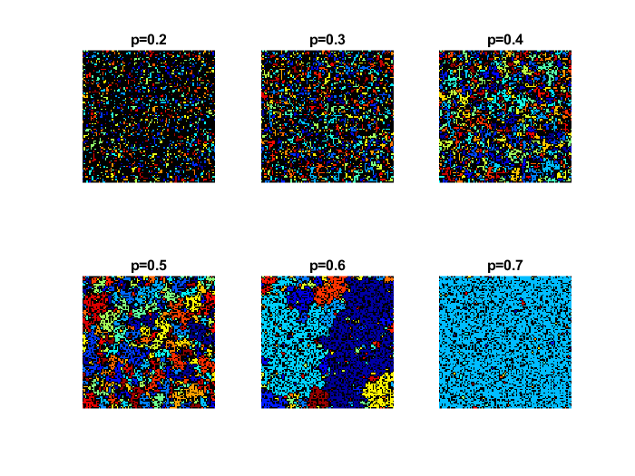
Percolation in 2-d (Numerical methods: Percolating clusters)
Each of the color represents each disjoint cluster
Anders Malthe-Sorenssen

Slide 17
L = 100;
pv = [0.2 0.3 0.4 0.5 0.6 0.7];
z = rand(L,L);
for i = 1:length(pv)
p = pv(i);
m = z<p;
[lw,num] = bwlabel(m,4); %%% marking the clusters
mat = lw;
img = label2rgb(lw,'jet','k','shuffle');
subplot(2,3,i)
tit=sprintf('p=%0.5g',p);
image(img); axis square;
title(tit);
axis off
end
Percolation in 2-d (Numerical methods: Percolating clusters)
Anders Malthe-Sorenssen

Slide 18
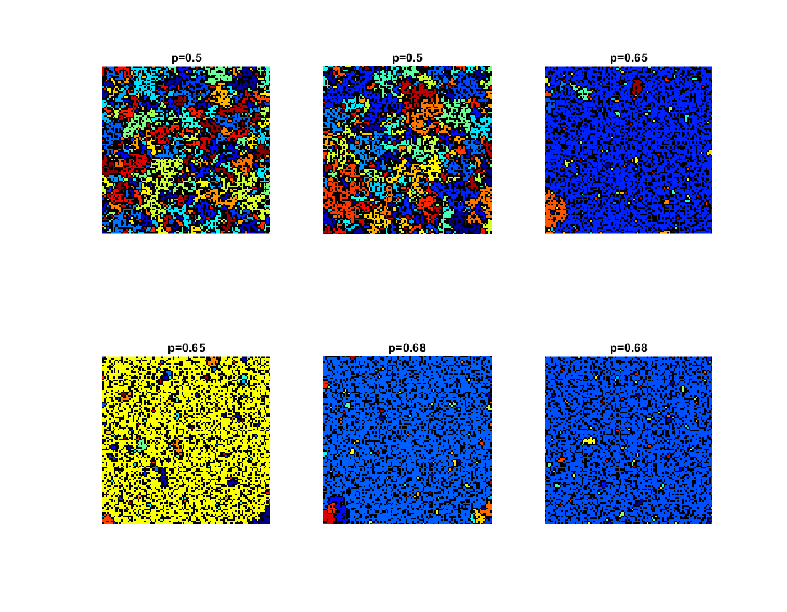
L = 100;
pv = [0.2 0.3 0.4 0.5 0.6 0.7];
z = rand(L,L);
for i = 1:length(pv)
p = pv(i);
m = z<p;
[lw,num] = bwlabel(m,4); %%% marking the clusters
mat = lw;
img = label2rgb(lw,'jet','k','shuffle');
subplot(2,3,i)
tit=sprintf('p=%0.5g',p);
image(img); axis square;
title(tit);
axis off
end
Percolation in 2-d (Percolating clusters) Near to critical points
Anders Malthe-Sorenssen

Slide 19
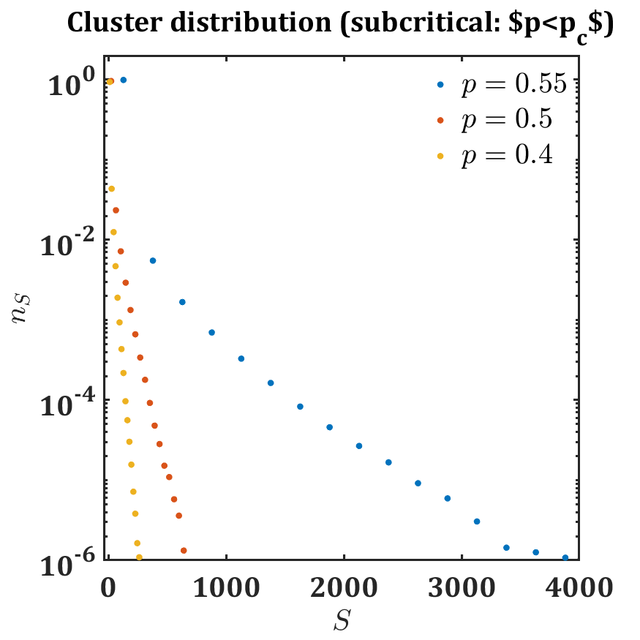
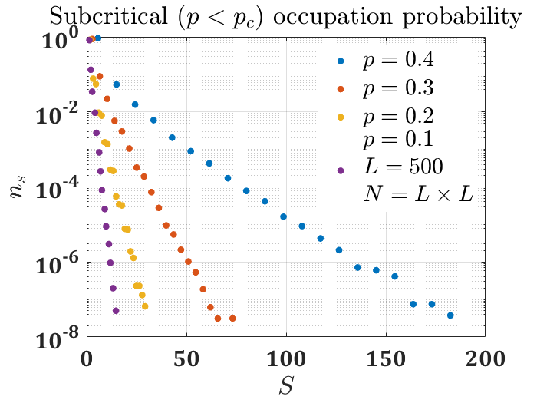
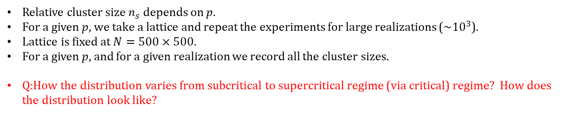
Percolation in 2-d : Cluster size distribution
Relative cluster size $n_{s}$ depends on $p$.
For a given $p$, we take a lattice and repeat the experiments for large realizations (~${10}^{3}$).
Lattice is fixed at $N=500×500.$
For a given $p$, and for a given realization we record all the cluster sizes.
Q:How the distribution varies from subcritical to supercritical regime (via critical) regime? How does the distribution look like?
H.J. Herrmann
Anders Malthe-Sorenssen

Slide 20
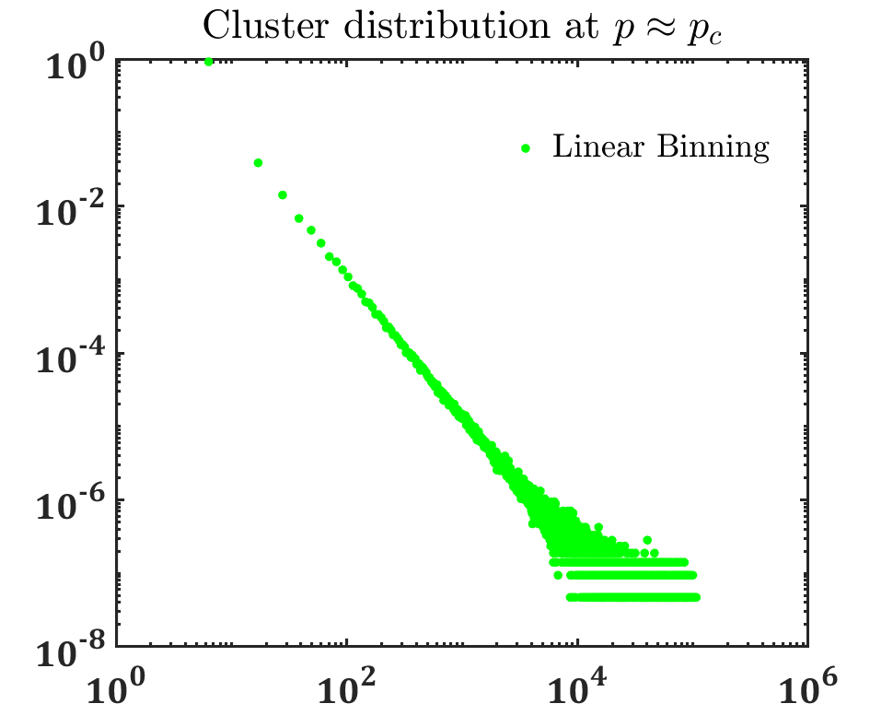
Percolation in 2-d : Cluster size distribution
Relative cluster size $n_{s}$ depends on $p$.
For a given $p$, we take a lattice and repeat the experiments for large realizations (~${10}^{3}$).
Lattice is fixed at $N=500×500.$
For a given $p$, and for a given realization we record all the cluster sizes.
Q:How the distribution varies from subcritical to supercritical regime (via critical) regime? How does the distribution look like?
H.J. Herrmann
Anders Malthe-Sorenssen

Slide 21
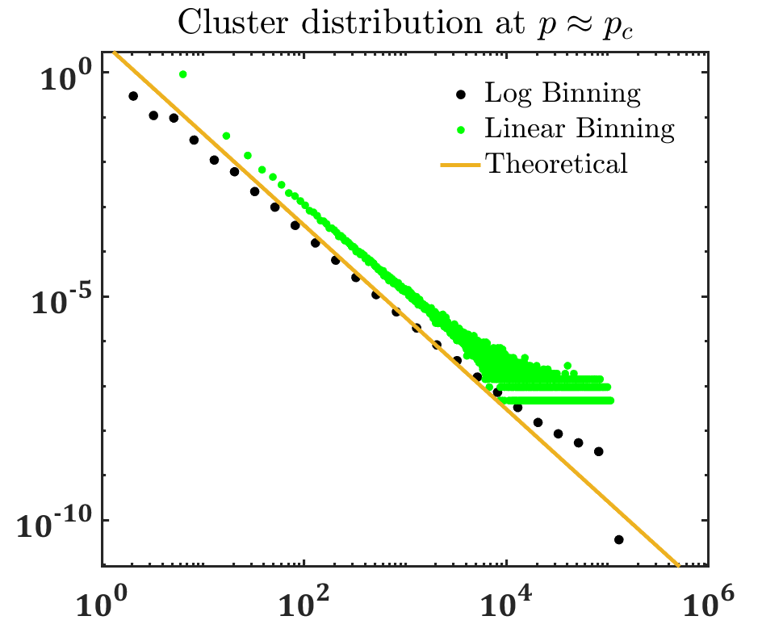
Percolation in 2-d : Cluster size distribution
Relative cluster size $n_{s}$ depends on $p$.
For a given $p$, we take a lattice and repeat the experiments for large realizations (~${10}^{3}$).
Lattice is fixed at $N=500×500.$
For a given $p$, and for a given realization we record all the cluster sizes.
Q:How the distribution varies from subcritical to supercritical regime (via critical) regime? How does the distribution look like?
H.J. Herrmann
Anders Malthe-Sorenssen

Slide 22
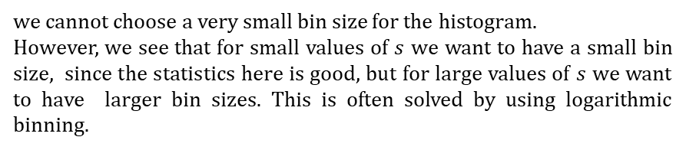
Percolation in 2-d : Cluster size distribution
%%%%^^^^log binning^^^^%%%%%
bins = 10.^(0.001:0.2:6);
[Lob, Lob2] =histcounts(zz(:,1),bins);
%%%[Loblin, Lob2lin] =hist(zz(:,1),10000);
ds = diff(bins);
sl = (bins(1:end-1)+bins(2:end))*0.5;
nsl = Lob(1:end)./(sum(Lob)*ds);
loglog(sl,nsl,'ok');
hold on;
we cannot choose a very small bin size for the histogram.
However, we see that for small values of $s$ we want to have a small bin size, since the statistics here is good, but for large values of $s$ we want to have larger bin sizes. This is often solved by using logarithmic binning.

Slide 23
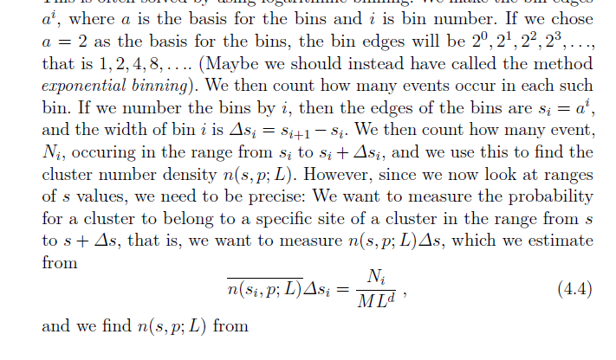
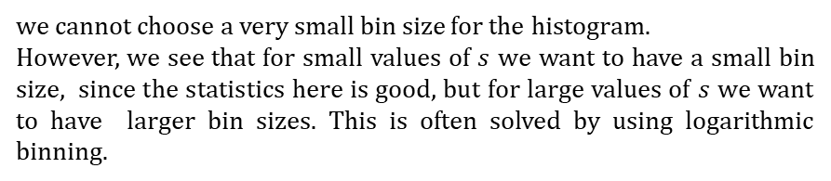
Percolation in 2-d : Cluster size distribution
%%%%^^^^log binning^^^^%%%%%
bins = 10.^(0.001:0.2:6);
[Lob, Lob2] =histcounts(zz(:,1),bins);
%%%[Loblin, Lob2lin] =hist(zz(:,1),10000);
ds = diff(bins);
sl = (bins(1:end-1)+bins(2:end))*0.5;
nsl = Lob(1:end)./(sum(Lob)*ds);
loglog(sl,nsl,'ok');
hold on;
we cannot choose a very small bin size for the histogram.
However, we see that for small values of $s$ we want to have a small bin size, since the statistics here is good, but for large values of $s$ we want to have larger bin sizes. This is often solved by using logarithmic binning.

Slide 24
Percolation in 2-d : Cluster size distribution
Q:How the distribution varies from subcritical to supercritical (via critical) regime? How does the distribution look like?
for L =500
%pv=0.4:-0.1:0.1;%0.4:0.02:1; %%% Subcritical
% pv=0.592746; %%% Critical
for i = 1:length(pv)
for j=1:5000
% j
z = rand(L,L);
p = pv(i);
m = z<p;
[lw,num] = bwlabel(m,4);
x=lw(1:end);
[GC,GR] = groupcounts(x');
GC1=GC;
ind= find (GR==0);
GC1(ind)=[];
zz=[zz;GC1];
%ZZ=[ZZ; L, j, p,{}];
x=[]; p=[];m=[]; GC1=[]; GC=[];
end
%%%%%%% Sub critical (Linear binning)%%%%%%
[a b]=hist(zz(:,1),20);
semilogx(b,(a)/sum(a),'.');
hold on;
%%%%%%%%%%%%%%%%%%%%%%%%%%%

Slide 25
Percolation in 2-d : Cluster size distribution
Q:How the distribution varies from subcritical to supercritical regime (via critical) regime? How does the distribution look like?
%%%%%%%% Critical %%%%%%%%%
%%%%^^^^log binning^^^^%%%%%
bins = 10.^(0.001:0.2:6);
[Lob, Lob2] =histcounts(zz(:,1),bins);
%%%[Loblin, Lob2lin] =hist(zz(:,1),10000);
ds = diff(bins);
sl = (bins(1:end-1)+bins(2:end))*0.5;
nsl = Lob(1:end)./(sum(Lob)*ds);
loglog(sl,nsl,'ok');
hold on;
%%%loglog(Lob2lin(1:end),Loblin(1:end)/sum(Loblin),'g.','MarkerSize',20);
%%%%%^^^^^^^^^^^^^^^^^%%%%%%%
set(findall(gcf,'-property','FontSize'),'FontName','Cambria',...
'FontSize',24,'linewidth',2.0,'fontweight','b’) ;
set(findall(gcf,'-property','FontSize'),'FontName','Cambria',...
'FontSize',24,'linewidth',2.0,'fontweight','b')
tau=187/91;
loglog(sl,5*sl.^(-tau),'-','linewidth',3);
end
end
for L =500
%pv=0.4:-0.1:0.1;%0.4:0.02:1;
pv=0.592746;
for i = 1:length(pv)
for j=1:5000
% j
z = rand(L,L);
p = pv(i);
m = z<p;
[lw,num] = bwlabel(m,4);
x=lw(1:end);
[GC,GR] = groupcounts(x');
GC1=GC;
ind= find (GR==0);
GC1(ind)=[];
zz=[zz;GC1];
%ZZ=[ZZ; L, j, p,{}];
x=[]; p=[];m=[]; GC1=[]; GC=[];
end

Slide 26
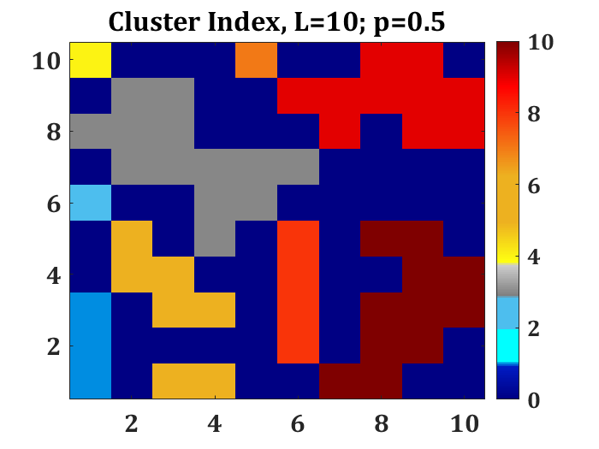
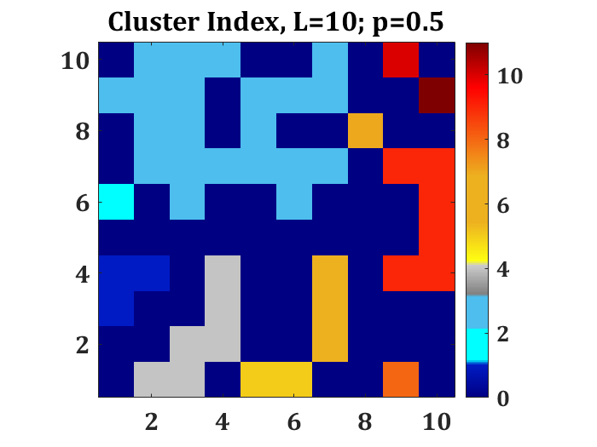
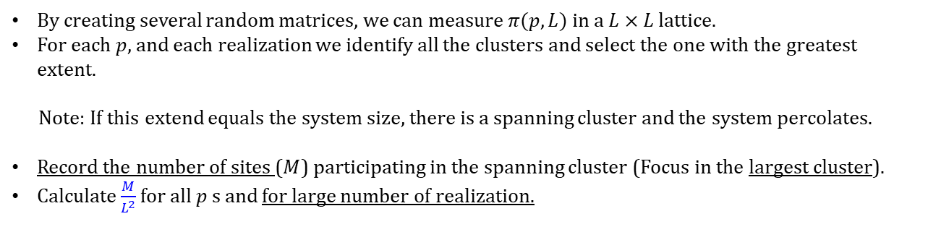
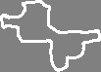
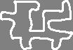
Percolation in 2-d
Q:How many of the sites belong the biggest cluster?
$P(p)$is the fraction of sites that belong to the biggest cluster. $P(p)$is the order parameter
By creating several random matrices, we can measure $π(p, L)$ in a $L×L$ lattice.
For each $p$, and each realization we identify all the clusters and select the one with the greatest extent.
Note: If this extend equals the system size, there is a spanning cluster and the system percolates.
Record the number of sites ($M$) participating in the spanning cluster (Focus in the largest cluster).
Calculate $\frac{M}{L^{2}}$ for all $p$ s and for large number of realization.

Slide 27
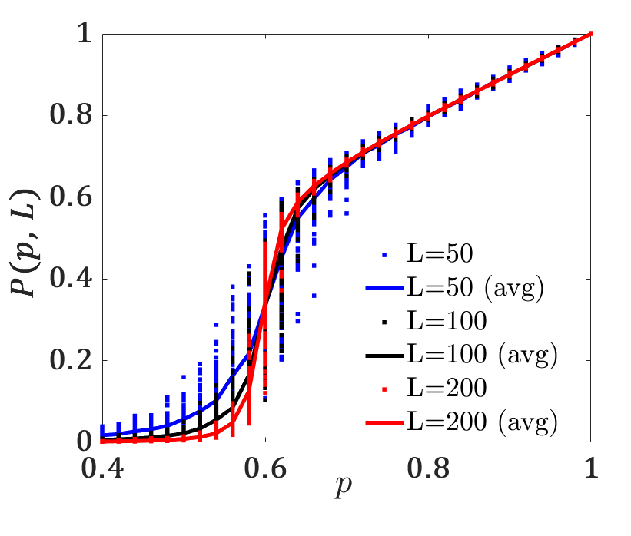
Percolation in 2-d
Q:How many of the sites belong the biggest cluster?
$P(p)$is the fraction of sites that belong to the biggest cluster. $P(p)$is the order parameter

Slide 28
Percolation in 2-d
clear all
ZZ=[];Q=[];
for L = 50:50:200
L
realization=100;
pv=0.4:0.02:1;
for i = 1:length(pv)
ll=0;
for j=1:realization
p = pv(i);
z = rand(L,L);
m = z<p;
[lw,num] = bwlabel(m,4);
x=lw(1:end);
[GC,GR] = groupcounts(x');
GC1=GC;
ind= find (GR==0);
GC1(ind)=[];
ll=ll+ max(GC1)/(L^2); %%% Averaging of large cluster
ZZ=[ZZ; L, j, p, max(GC1), max(GC1)/(L^2)];
x=[]; m=[]; GC1=[]; GC=[];
% mat = lw;
% img = label2rgb(lw,'jet','k','shuffle');
% subplot(2,3,i)
% tit=sprintf('p=%0.5g',p);
% image(img);
end
Q=[Q; L,p,ll/realization];
p=[];
end
end

Slide 29
Percolation in 2-d : Density of the spanning cluster
The probability $P(p, L)$for a site to belong to a spanning cluster is called the density of the spanning cluster, or the order parameter for the percolation problem.

Slide 30
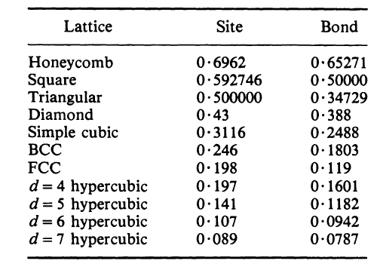
Percolation in 2-d : Density of the spanning cluster
The probability $P(p, L)$for a site to belong to a spanning cluster is called the density of the spanning cluster, or the order parameter for the percolation problem.
clear all
ZZ=[];Q=[];
for L = 50:50:200
L
realization=100;
pv=0.4:0.02:1;
for i = 1:length(pv)
ll=0;
for j=1:realization
p = pv(i);
z = rand(L,L);
m = z<p;
[lw,num] = bwlabel(m,4);
x=lw(1:end);
[GC,GR] = groupcounts(x');
GC1=GC;
ind= find (GR==0);
GC1(ind)=[];
ll=ll+ max(GC1)/(L^2); %%% Averaging of large cluster
ZZ=[ZZ; L, j, p, max(GC1), max(GC1)/(L^2)];
x=[]; m=[]; GC1=[]; GC=[];
% mat = lw;
% img = label2rgb(lw,'jet','k','shuffle');
% subplot(2,3,i)
% tit=sprintf('p=%0.5g',p);
% image(img);
end
Q=[Q; L,p,ll/realization];
p=[];
end
end
indL=find(ZZ(:,1)==50);
figure; plot(ZZ(indL,3),ZZ(indL,5),'.b');
hold on;
indL1=find(Q(:,1)==50);
plot(Q(indL1,2),Q(indL1,3),'b', 'linewidth',3);
indL=[]; indL1=[];
indL=find(ZZ(:,1)==100);
hold on;
plot(ZZ(indL,3),ZZ(indL,5),'.k');hold on;
indL1=find(Q(:,1)==100);
plot(Q(indL1,2),Q(indL1,3),'k', 'linewidth',3);
indL=[]; indL1=[];
indL=find(ZZ(:,1)==200);
hold on; plot(ZZ(indL,3),ZZ(indL,5),'.r');hold on;
indL1=find(Q(:,1)==200);
plot(Q(indL1,2),Q(indL1,3),'r', 'linewidth',3);
indL=[]; indL1=[];

Slide 31
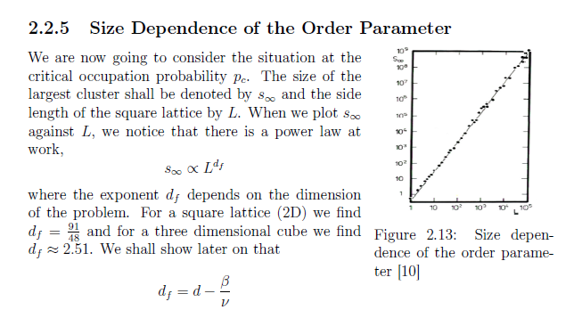
Percolation in 2-d

Slide 32

Introduction to Random Graph
Chittaranjan Hens
IIIT-Hyderabad

Slide 33
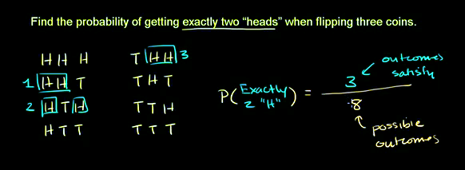
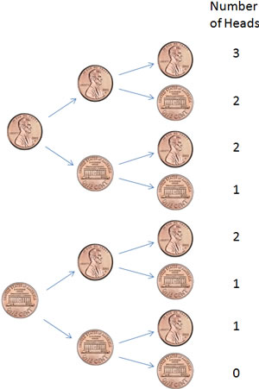
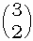
Random graph: Preliminaries (Flipping a coin)
Probability of getting exactly 2 heads when flipping 3 coins P(2) =
×
p²(1 − p)²
Khan Academy

Slide 34
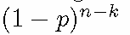
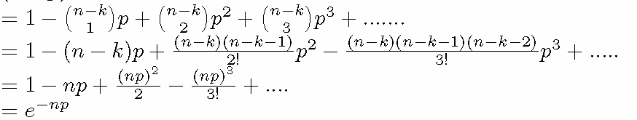
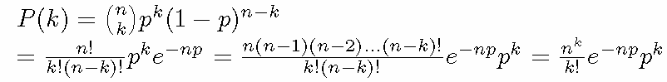
Random graph: Preliminaries
(Binomial distribution and Poisson distribution)
The probability of getting exactly k successes in n trials is given
by the probability mass function:
k = 0, 1, 2, ..., n
-
For large n
known as the Poisson distribution

Slide 35
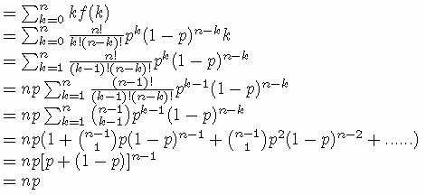
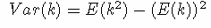
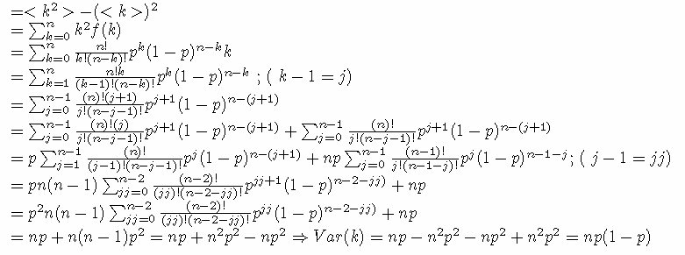
Random graph: Preliminaries
(Binomial distribution and Poisson distribution)
Mean/expectation value
=
Variance

Slide 36
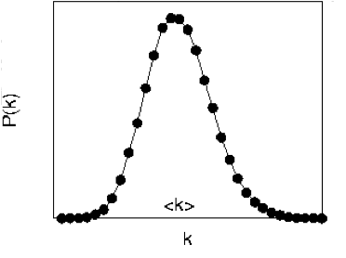
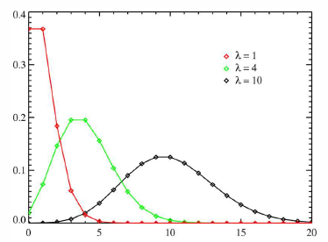
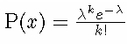
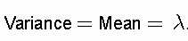
Random graph: Preliminaries
(Binomial distribution and Poisson distribution)
Binomial distribution
Expectation/Mean
Variance
Poisson distribution
k

Slide 37
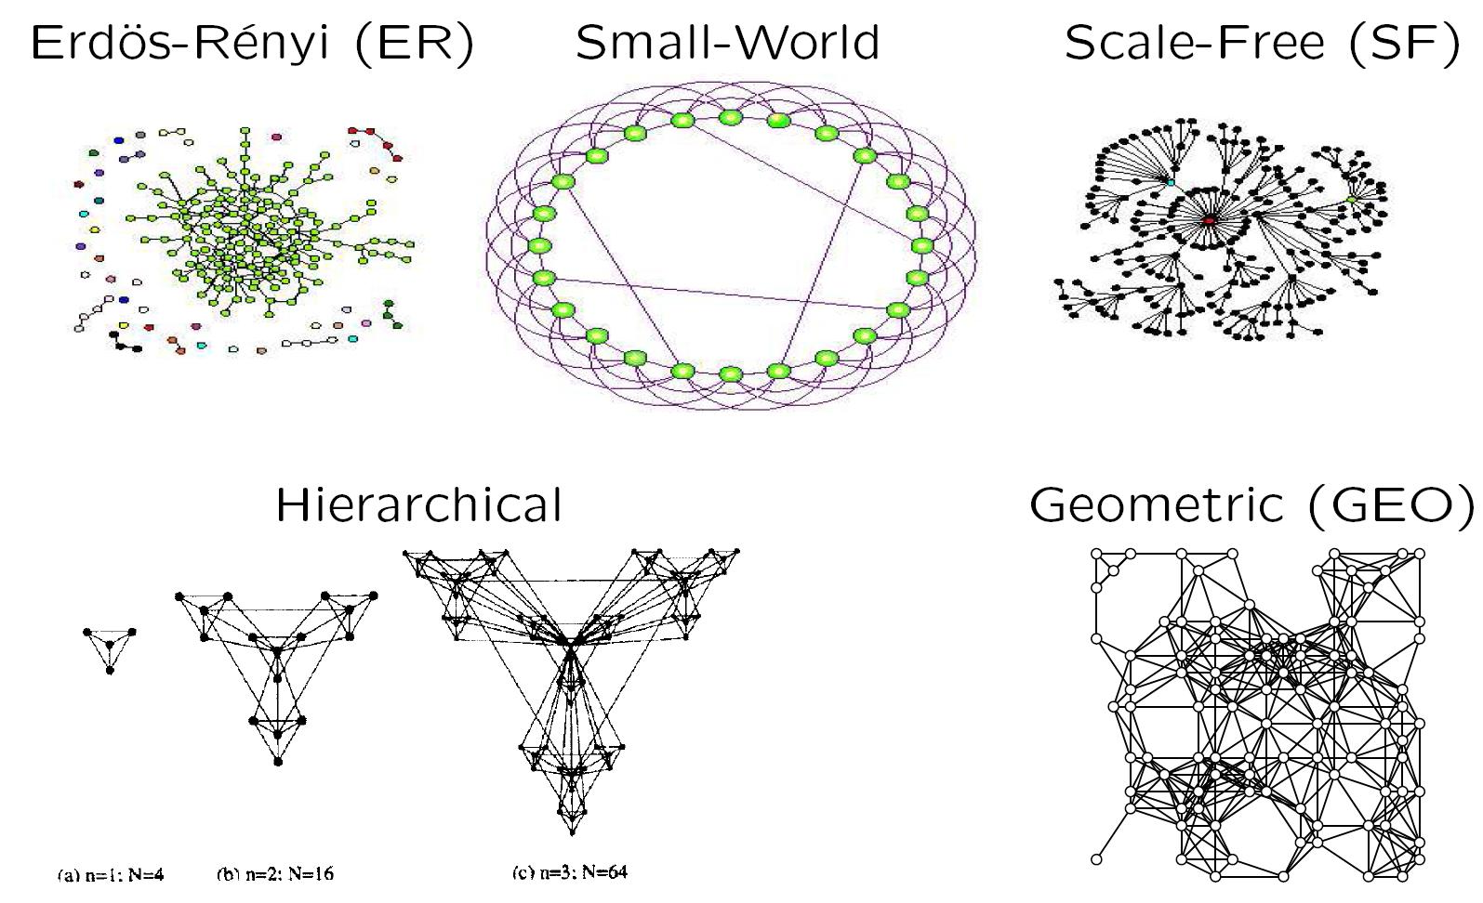
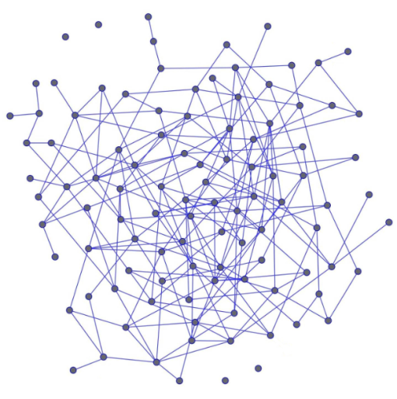
What is a network (graph) model?

Slide 38
Network models
We will cover the following network models:
Erdos–Renyi random graphs
Small-world networks
Scale-free networks
Generalized random graphs (with the same degree distribution as the data networks)
Hierarchical model
Geometric random graphs

Slide 39
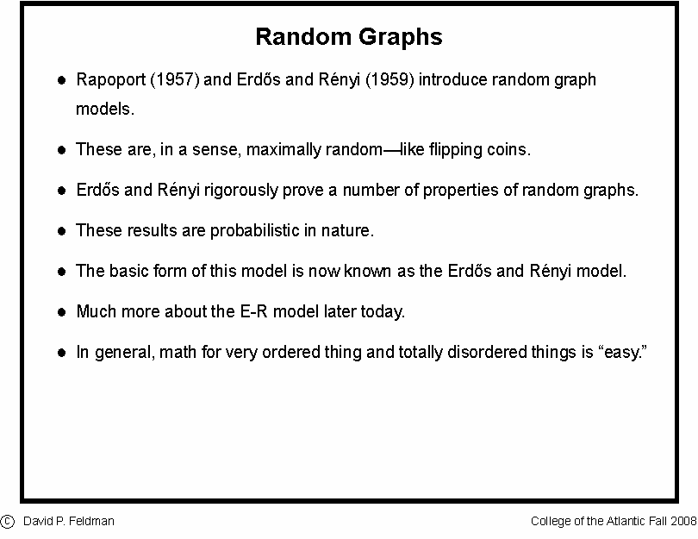
Random Graph: An insight within

Slide 40
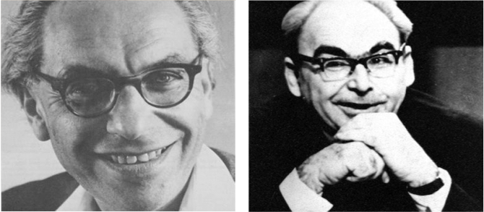
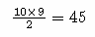
Random Graph: An insight within
Pál Erdös
(1913-1996)
Alfréd Rényi
(1921-1970)
Construction
Erdös-Rényi model (1960)
Connect with probability p
p=1/6 N=10
⟨k⟩ ~ 1.5
Total number of connections =
Possible number of connections with probability 1/6
=
Network Science: Random Graphs 2012
Barabasi Group ppt

Slide 41
Percolation process: emergence of giant component

Slide 42
Percolation in 2-d

Slide 43
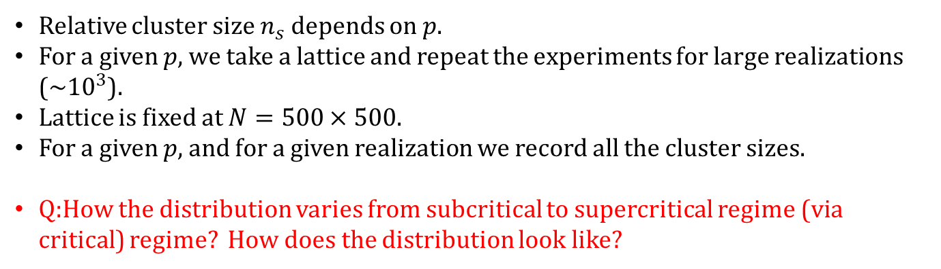
Percolation in 2-d : Cluster size distribution
Relative cluster size $n_{s}$ depends on $p$.
For a given $p$, we take a lattice and repeat the experiments for large realizations (~${10}^{3}$).
Lattice is fixed at $N=500×500.$
For a given $p$, and for a given realization we record all the cluster sizes.
Q:How the distribution varies from subcritical to supercritical regime (via critical) regime? How does the distribution look like?
H.J. Herrmann
Anders Malthe-Sorenssen

Slide 44
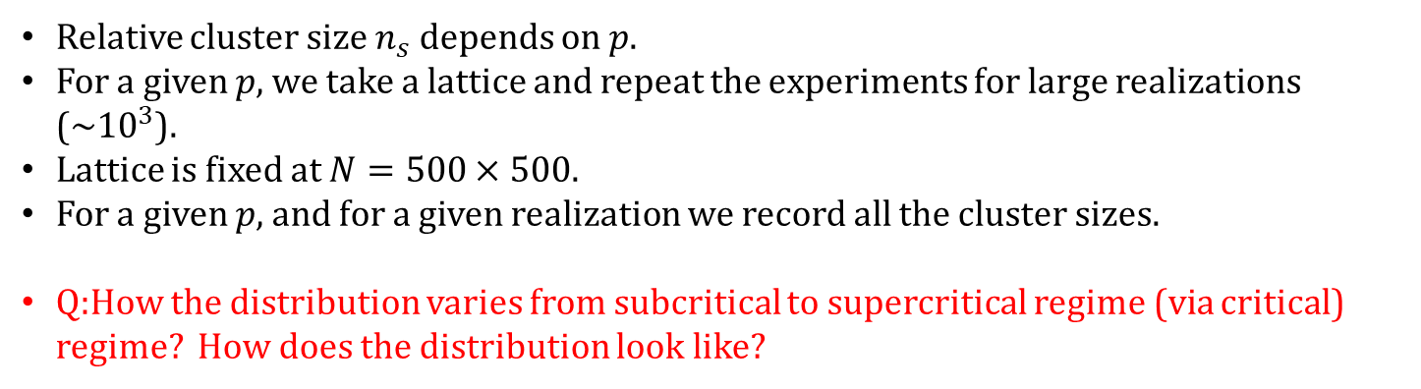
Percolation in 2-d : Cluster size distribution
Relative cluster size $n_{s}$ depends on $p$.
For a given $p$, we take a lattice and repeat the experiments for large realizations (~${10}^{3}$).
Lattice is fixed at $N=500×500.$
For a given $p$, and for a given realization we record all the cluster sizes.
Q:How the distribution varies from subcritical to supercritical regime (via critical) regime? How does the distribution look like?
H.J. Herrmann
Anders Malthe-Sorenssen

Slide 45
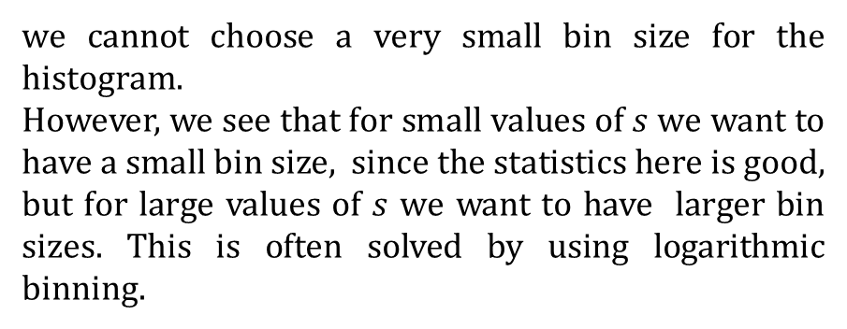
Percolation in 2-d : Cluster size distribution
%%%%^^^^log binning^^^^%%%%%
bins = 10.^(0.001:0.2:6);
[Lob, Lob2] =histcounts(zz(:,1),bins);
%%%[Loblin, Lob2lin] =hist(zz(:,1),10000);
ds = diff(bins);
sl = (bins(1:end-1)+bins(2:end))*0.5;
nsl = Lob(1:end)./(sum(Lob)*ds);
loglog(sl,nsl,'ok');
hold on;
we cannot choose a very small bin size for the histogram.
However, we see that for small values of $s$ we want to have a small bin size, since the statistics here is good, but for large values of $s$ we want to have larger bin sizes. This is often solved by using logarithmic binning.

Slide 46
Percolation in 2-d : Cluster size distribution
%%%%^^^^log binning^^^^%%%%%
bins = 10.^(0.001:0.2:6);
[Lob, Lob2] =histcounts(zz(:,1),bins);
%%%[Loblin, Lob2lin] =hist(zz(:,1),10000);
ds = diff(bins);
sl = (bins(1:end-1)+bins(2:end))*0.5;
nsl = Lob(1:end)./(sum(Lob)*ds);
loglog(sl,nsl,'ok');
hold on;
we cannot choose a very small bin size for the histogram.
However, we see that for small values of $s$ we want to have a small bin size, since the statistics here is good, but for large values of $s$ we want to have larger bin sizes. This is often solved by using logarithmic binning.

Slide 47
Percolation in 2-d : Cluster size distribution
Q:How the distribution varies from subcritical to supercritical (via critical) regime? How does the distribution look like?
for L =500
%pv=0.4:-0.1:0.1;%0.4:0.02:1; %%% Subcritical
% pv=0.592746; %%% Critical
for i = 1:length(pv)
for j=1:5000
% j
z = rand(L,L);
p = pv(i);
m = z<p;
[lw,num] = bwlabel(m,4);
x=lw(1:end);
[GC,GR] = groupcounts(x');
GC1=GC;
ind= find (GR==0);
GC1(ind)=[];
zz=[zz;GC1];
%ZZ=[ZZ; L, j, p,{}];
x=[]; p=[];m=[]; GC1=[]; GC=[];
end
%%%%%%% Sub critical (Linear binning)%%%%%%
[a b]=hist(zz(:,1),20);
semilogx(b,(a)/sum(a),'.');
hold on;
%%%%%%%%%%%%%%%%%%%%%%%%%%%

Slide 48
Percolation in 2-d : Cluster size distribution
Q:How the distribution varies from subcritical to supercritical regime (via critical) regime? How does the distribution look like?
%%%%%%%% Critical %%%%%%%%%
%%%%^^^^log binning^^^^%%%%%
bins = 10.^(0.001:0.2:6);
[Lob, Lob2] =histcounts(zz(:,1),bins);
%%%[Loblin, Lob2lin] =hist(zz(:,1),10000);
ds = diff(bins);
sl = (bins(1:end-1)+bins(2:end))*0.5;
nsl = Lob(1:end)./(sum(Lob)*ds);
loglog(sl,nsl,'ok');
hold on;
%%%loglog(Lob2lin(1:end),Loblin(1:end)/sum(Loblin),'g.','MarkerSize',20);
%%%%%^^^^^^^^^^^^^^^^^%%%%%%%
set(findall(gcf,'-property','FontSize'),'FontName','Cambria',...
'FontSize',24,'linewidth',2.0,'fontweight','b’) ;
set(findall(gcf,'-property','FontSize'),'FontName','Cambria',...
'FontSize',24,'linewidth',2.0,'fontweight','b')
tau=187/91;
loglog(sl,5*sl.^(-tau),'-','linewidth',3);
end
end
for L =500
%pv=0.4:-0.1:0.1;%0.4:0.02:1;
pv=0.592746;
for i = 1:length(pv)
for j=1:5000
% j
z = rand(L,L);
p = pv(i);
m = z<p;
[lw,num] = bwlabel(m,4);
x=lw(1:end);
[GC,GR] = groupcounts(x');
GC1=GC;
ind= find (GR==0);
GC1(ind)=[];
zz=[zz;GC1];
%ZZ=[ZZ; L, j, p,{}];
x=[]; p=[];m=[]; GC1=[]; GC=[];
end

Slide 49
Percolation in 2-d : Density of the spanning cluster
The probability $P(p, L)$for a site to belong to a spanning cluster is called the density of the spanning cluster, or the order parameter for the percolation problem.
clear all
ZZ=[];Q=[];
for L = 50:50:200
L
realization=100;
pv=0.4:0.02:1;
for i = 1:length(pv)
ll=0;
for j=1:realization
p = pv(i);
z = rand(L,L);
m = z<p;
[lw,num] = bwlabel(m,4);
x=lw(1:end);
[GC,GR] = groupcounts(x');
GC1=GC;
ind= find (GR==0);
GC1(ind)=[];
ll=ll+ max(GC1)/(L^2); %%% Averaging of large cluster
ZZ=[ZZ; L, j, p, max(GC1), max(GC1)/(L^2)];
x=[]; m=[]; GC1=[]; GC=[];
% mat = lw;
% img = label2rgb(lw,'jet','k','shuffle');
% subplot(2,3,i)
% tit=sprintf('p=%0.5g',p);
% image(img);
end
Q=[Q; L,p,ll/realization];
p=[];
end
end
indL=find(ZZ(:,1)==50);
figure; plot(ZZ(indL,3),ZZ(indL,5),'.b');
hold on;
indL1=find(Q(:,1)==50);
plot(Q(indL1,2),Q(indL1,3),'b', 'linewidth',3);
indL=[]; indL1=[];
indL=find(ZZ(:,1)==100);
hold on;
plot(ZZ(indL,3),ZZ(indL,5),'.k');hold on;
indL1=find(Q(:,1)==100);
plot(Q(indL1,2),Q(indL1,3),'k', 'linewidth',3);
indL=[]; indL1=[];
indL=find(ZZ(:,1)==200);
hold on; plot(ZZ(indL,3),ZZ(indL,5),'.r');hold on;
indL1=find(Q(:,1)==200);
plot(Q(indL1,2),Q(indL1,3),'r', 'linewidth',3);
indL=[]; indL1=[];

Slide 50
Percolation in 2-d

Slide 51
Properties of Random Network
Many properties of ER can be proven theoretically
(See: Bollobas, "Random Graphs," 2002)
Example:
When m=n/2,suddenly the giant component emerges, i.e.:
One connected component of the network has O(n) nodes
The next largest connected component has O(log(n)) nodes

Slide 52

Properties of Random Network
If $pN < 1$ ($Np=⟨k⟩$), then a graph in G(N, p) will almost surely have no connected components of size larger than $O(log⁡(N)).$
If $pN = 1$, then a graph in G(N, p) will almost surely have a largest component whose size is of order N$2/3$.
If $pN → c > 1$, where c is a constant, then a graph in G(N, p) will almost surely have a unique giant component containing a positive fraction of the vertices. No other component will contain more than $O(log⁡(N))$vertices.
wiki

Slide 53



Properties of Random Network
Sub critical Regime ($0<\left\langle k\right\rangle <1$) ($p<\frac{1}{N}$)
$\left\langle k \right\rangle =0,$ isolated nodes.
$\left\langle k \right\rangle$ increases imply ~$N⟨k⟩$ links are added in the system.
$\left\langle k\right\rangle <1$ a small number of links emerge in this regime, hence tiny clusters will appear.
What will be size of the largest cluster?
$$O(log⁡(N)).$$
wiki

Slide 54


Properties of Random Network
Critical Regime ($\left\langle k\right\rangle =1$) ($p=\frac{1}{N}$)
What will be the size of the largest cluster?
$$N2/3$$
Relative size is still zero. However there will be a significant jump in largest magnitude of the largest cluster.
Different size of cluster coexist (from power law)
Giant components will have loops
Small componnets are still tree
wiki

Slide 55
Properties of Random Network
Super critical Regime ($\left\langle k\right\rangle >1$) ($p>\frac{1}{N}$)
At critical
What will be the size of the largest cluster? (size of N)
The further we move from the critical point, the larger fraction of nodes will belong to it.
In the supercritical regime, numerous isolated components coexist with the giant component
These small components are trees, while the giant component contains loops and cycles. The supercritical regime lasts until the giant component absorbs all nodes.
wiki

Slide 56


Properties of Random Network
Connected Regime ($\left\langle k\right\rangle >ln(N)$) ($p>\frac{ln(N)}{N}$)
For sufficiently large $p$ the giant component absorbs all nodes and components,
hence $NG≃ N$. In the absence of isolated nodes the network becomes connected.
The average degree at which this happens depends on N as
$\left\langle k\right\rangle =\ln{N}$
In summary, the random network model predicts that the emergence of a network is not a smooth, gradual process: The isolated nodes and tiny components observed for small <k> collapse into a giant component through a phase transition
wiki

Slide 57
Properties of Random Network
wiki

Slide 58
Properties of Random Network
wiki

Slide 59

Giant Component
A network component whose size grows in proportion to $n$ is called giant component
Let $u$ be the fraction of nodes that do not belong to the giant component. Hence,
If there is no giant component → $u=1$
If there is giant component → $u<1$
In order for a node $i$ not to connect to the giant component:
$i$ needs not connect to any other node $j→1−p$
$i$ is connected to $j$, but $j$ itself is not connected to the giant component $→ pu$

Slide 60

Giant Component
Hence, the total probability of $i$ not being connected to giant component via vertex j is: $1−p+pu$
Considering all $n−1$ vertices through which i can connect:
Taking the logarithms at both sides and the Taylor approximation for large n:
This equation cannot be solved in close form

Slide 61

Giant Component
We plot $y=1−e−cS$with $S$ between 0 and 1 (since it represents fraction of nodes)
We also plot $y=S$
The point where the two curves intersect is the solution
For small c only one solution
$S=0$
For greater c there might be two
solutions
The point where two solutions start
appearing is when the gradients of the two
curves are equal at $S=0$
This happens for $c=1$

Slide 62
Giant Component
Until now we have proved that if c≤1 there cannot be any giant component
However, we have not proved what happens if c>1
How can we be sure that there is a giant component?
After all there are two solutions to the equation; one for S=0 and one for larger S
The periphery of this initially small
component can only increase if c>1

Slide 63
Giant Component
We expect a giant component iff c > 1

